Slide 1
Notes:
PLEASE DO NOT DELETE THIS SLIDE. THIS IMAGE/DISCLAIMER MUST BE AT THE START OF EVERY CANVAS LIVE SESSION

Slide 2
When High Tech becomes Hot Tech: Educational Technology Showcase - Part 3
Dr. Sean Nufer
Thad Stott
TCS Education System
snufer@tcsedsystem.edu | tstott@tcsedsystem.edu

Slide 3
Header/HEADER
Bullet
Bullet
Bullet
Bullet
Text-text
[Copy/modify/edit this slide, as needed.]

Slide 4
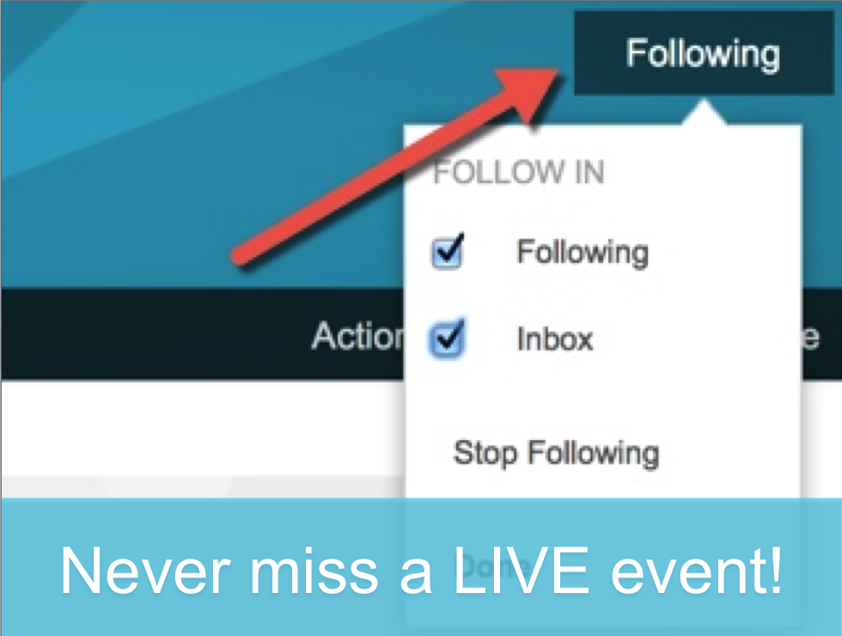
Get Involved...
live.canvasLMS.com ‘Follow’ to be notified of upcoming events
Join the CanvasLIVE user group Collaborate on presentations with other users
Hangout in our Canvas Chatrooms Connect in real-time with other Canvas users

